Slide 1
MRM Update and
Business Model
MISA Board of Directors
May 13, 2011

Slide 2
Municipal Reference Model
What is the MRM: MRM Refresher
MRMv2 Project Update: Where are we now?
MRMv2 Business Model

Slide 3
What is the MRM
MRM Refresher

Slide 4
MRM v2 Vision
In response to renewed interest:
A tool (product, service) to help municipalities describe their business from a client-centric perspective: in terms of the programs and services they provide
…in a standard way
…using precise definitions and concepts accepted and adopted by all governments in Canada
…with tools and templates
…with user guides and training material
…with a repository where these descriptions can be saved
…repository pre-populated with a generic set of municipal services and service profiles
…allowing each municipality to load and customize their service descriptions and associated data and share with other users
…with tools that allow for the analysis and comparison
…and a collaboration space that allows ideas to be shared on how these tools are being used in participating municipalities

Slide 5
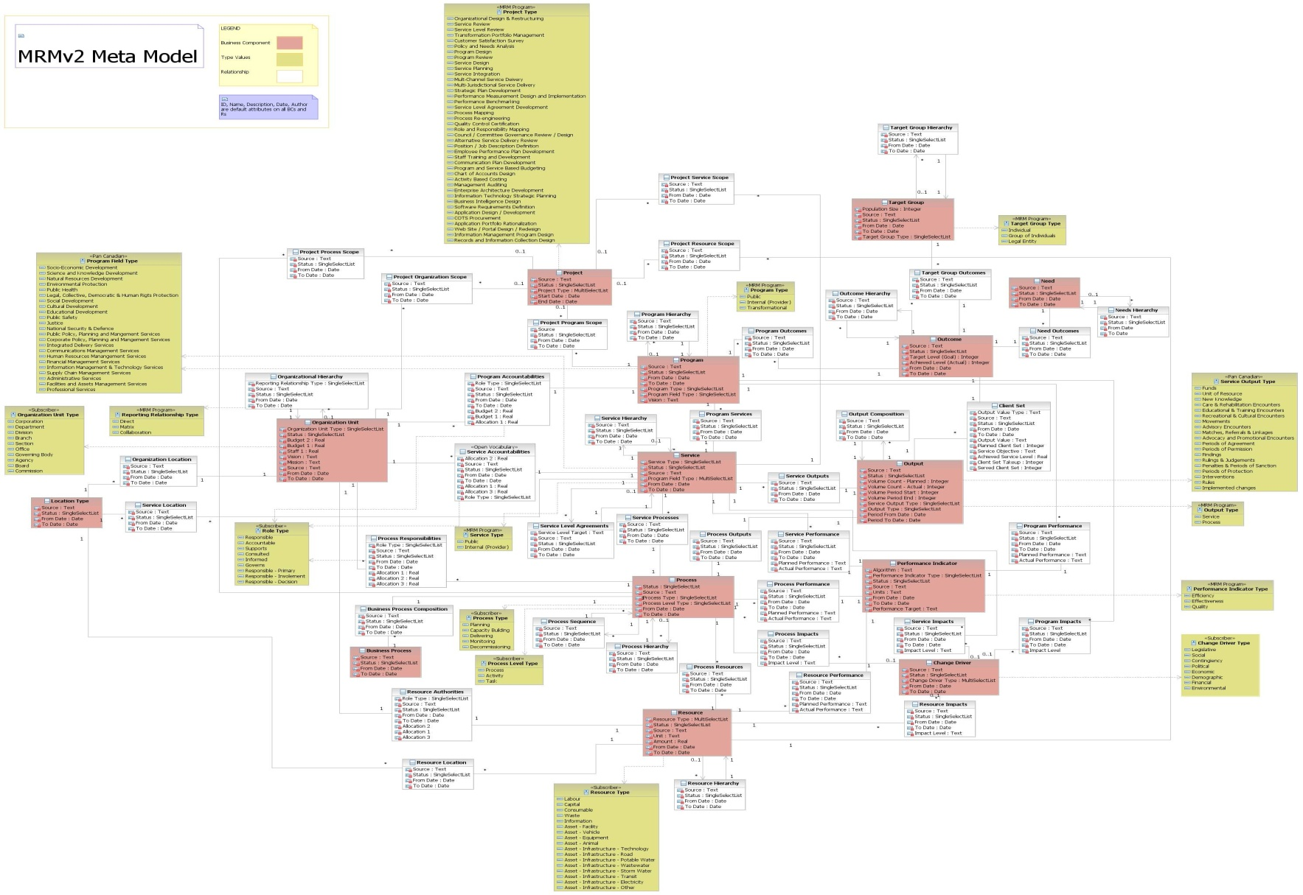
MRMv2 Meta-Model
CAUTION: DO NOT TRY TO READ THIS SLIDE!
Notes:
Caution reading this slide of the “meta model” where “pink” entities are core entities, “white entities: are intersection entities, and “dijon mustard yellow” entities are type tables.

Slide 6
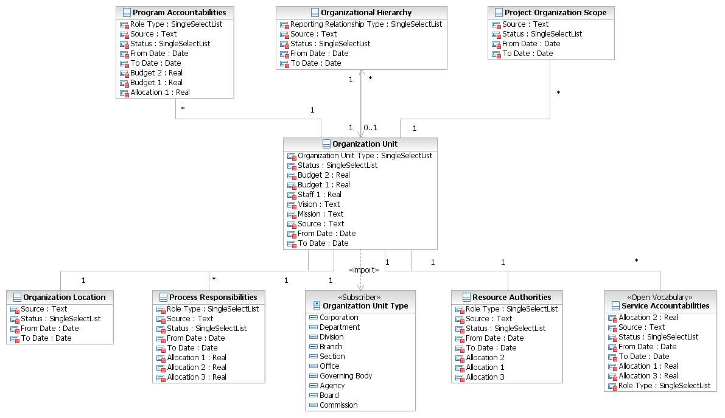
MRMv2 Meta-Model Extract
Notes:
A diagram illustrating the “meta model” element associated with an Organization Unit and how it is related to “first level” entities.

Slide 7
MRMv2 Selected Standard Vocabulary
Strategic Terms:
  Vision
  Mission
  Core Values
Program Terms:
  Program Goal
  Program Need
  Program Outcome
  Program Target Group
Service Terms:
  Service Output
  Service Output Type
  Process
  Activity
  Task
  Client
  Service Value (to client)
Performance Metric Terms:
  Efficiency
  Effectiveness
  Quality
Role Terms:
  Governance
  Accountability
  Responsibility
  Authority
  Activity
Enterprise Architecture Terms:
  Mandate
  Events
  Cycles
  Jurisdiction

Slide 8
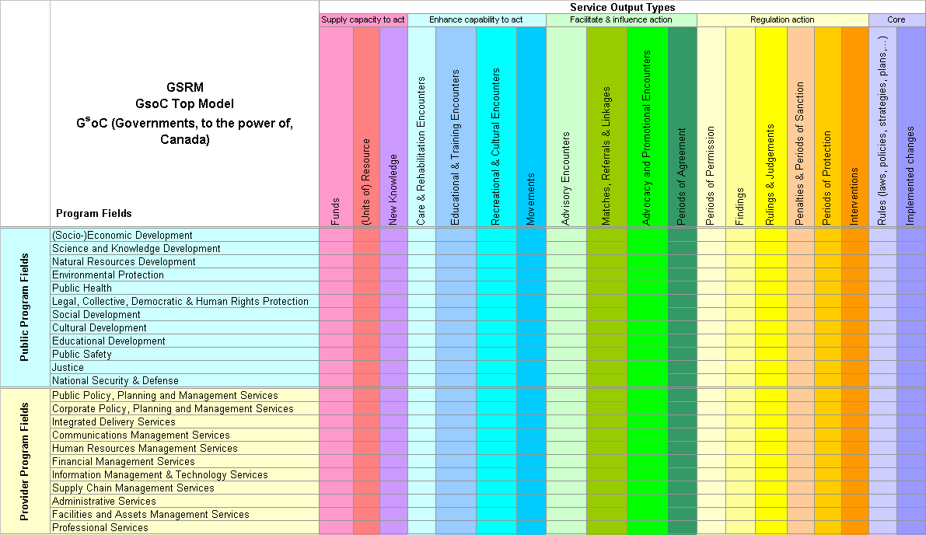
MRMv2 Standard Value Lists
Source: Government of Canada Strategic Reference Model (GSRM) specification

Slide 9
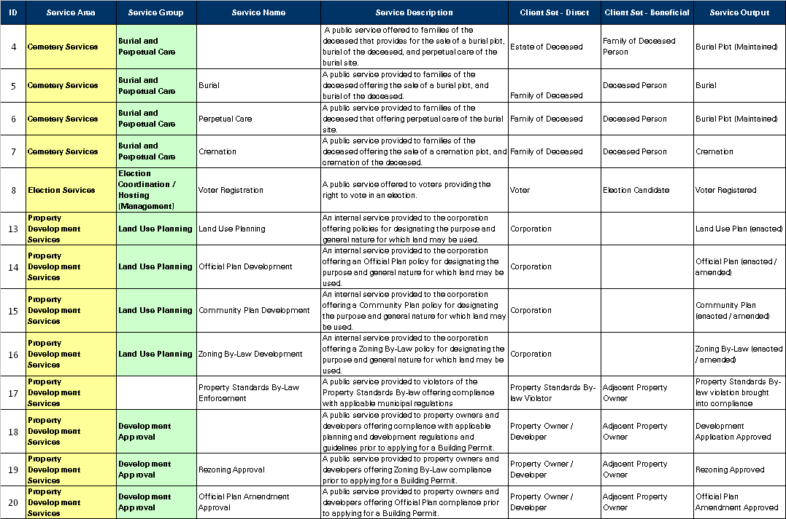
MRMv2 Reference Model
of Municipal Programs and Services
About 100 high-level municipal services; Over 1,000 detail-level municipal services
Notes:
Sample Reference Model Services – Currently Under Development!

Slide 10
MRMv2 Standard Set of Programs & Service Profiles
Emergency Care and Preventative Care Service
Service Type | Public
Accountable Unit | EMS
Purpose Statement | Provide excellent emergency and preventative care services to the people of Toronto through activities such as providing pre hospital emergency care, community medicine and inter facility patient transport services
Customer | EMS Patient Family / Relatives
Products / Types | Primary /Advanced Critical | Stand By special event Stand By Emergency
Output | EMS Emergency Care, Preventative Care, Facility Transport
Delivery Method | Upon Request
Service Level | 24/7/365
Efficiency | $ / Emergency Care & Preventative Care by type
Value Statement | improved health reduction in mortality | reduced pain reduced health care cost
Effectiveness | Response Time to Incident ( Road Response Time + Process Time) Correct Resource response time according to Call priority (90% of the time) Percentage of Unit Hour Utilization | Cost of Unit Hour Production Mean Hospital Wait Time (Total Wait Time / # of Hospital Visit ) # of Public Access Defibrillators
Service Objective | Improve the response time to life threatening calls (delta & echo) from 70% to 90% within 8:59 minutes and stated targets for alpha, bravo and charlie category type calls. Reduce the in hospital time from 60 minutes to 45 minutes by 2008
Community Impact | Health Care Public Safety

Slide 11
MRMv2 Components
MRM Reference Model
(i.e. Public Safety Program, Fire Rescue Service, etc.)
Customized “My Municipality’s” Model
MRM Meta-Model
(i.e. Shell Program, Shell Service, etc.)
Customized Municipality C Model
Best Practice Model
(i.e. AWWA Potable Water Supply Service, etc.)
Customized Municipality B Model
Customized Municipality A Model

Slide 12
MRMv2 Project Update
Where are we now?

Slide 13
MRMv2 - Back On Track
  Availability delayed: initially planned for Summer 2010
Some bumps in the road:
  Issue: selected IBM software was not an ideal fit
    Pilots conducted by the City of Toronto indicated that the selected IBM software was not an ideal fit for an MRM community - primarily business users rather than IT architects
  Resolution: new toolset selected
    Following MISA Ontario 2010 Conference, IBM undertook an “architectural review”
    New toolset recommended, based on Rational (formerly Telelogic, Popkin) System Architect.

Slide 14
MRMv2 - Back On Track continued
Issue: software licensing
  MISA had licensed toolset based on Rational
  Requisite Pro (as initially recommended by IBM)
  Requisite Pro solution required IBM to custom-code interface between different ReqPro products
Resolution: exchange licences
  Fall 2010, IBM confirmed that we could exchange previously purchased software for equivalent value in System Architect licences
  System Architect solution fully integrated, requiring no IBM custom code – but does require substantial configuration to “understand” the MRM

Slide 15
MRMv2 - Back On Track continued
System Architect (SA) toolset
  Now installed at e-Solutions hosting site
  MRM Meta-Model and Reference Model loaded into System Architect (by IBM/Jim Amsden)
Second Pilot: Region of Peel
  Loading Region of Peel services, strategic plan goals
  Preliminary results – much improved ease of use along with improved system functionality
  Fully integrated solution
  Generating reports and diagrams to test / illustrate
  the value of the SA tool
Availability: Full demonstration planned for MISA 2011 Conference in June

Slide 16
MRMv2 - Back On Track continued
MRM Standards Board
  Approve content of the MRM meta-model and Reference Model, as recommended by Working Groups
Meta-Model Working Group (MMWG)
  Recommend content of the meta-model (entities, definitions, attributes, relationships, value lists, including how they are implemented in System Architect
  Membership: Skip Lumley, Alan Mitchell, Roy Wiseman, Jim Amsden (IBM)
Reference Model Working Group (RMWG)
  Review and recommend > 1,000 Services / Service Profiles (integrating work from five participating municipalities: Edmonton, Fredericton, Peel, Toronto, Windsor
  Membership: “Experts” from these five municipalities

Slide 17
MRMv2 - Back On Track continued
Business Model Working Group
    To deliver on our commitments to existing
    contributors
    To develop a long term business plan to reflect
    municipal interests and opportunities
    Membership: John Johnston, Geovanni Mosquera, Louis Shallal, Roy Wiseman, Stephen Wong
Other Issues
  Intellectual Property – working with Miller-Thompson
  Relationship Agreement Update – under discussion with IBM

Slide 18
MRMv2 Business Model:
Short Term

Slide 19
Business Model Working Group
We believe that this business model addresses the short term viability and sustainability of the MRMv2 products and services.
Further work on the long term vision and growth strategy needs to be completed after “testing the market” with the initial release of the product.

Slide 20
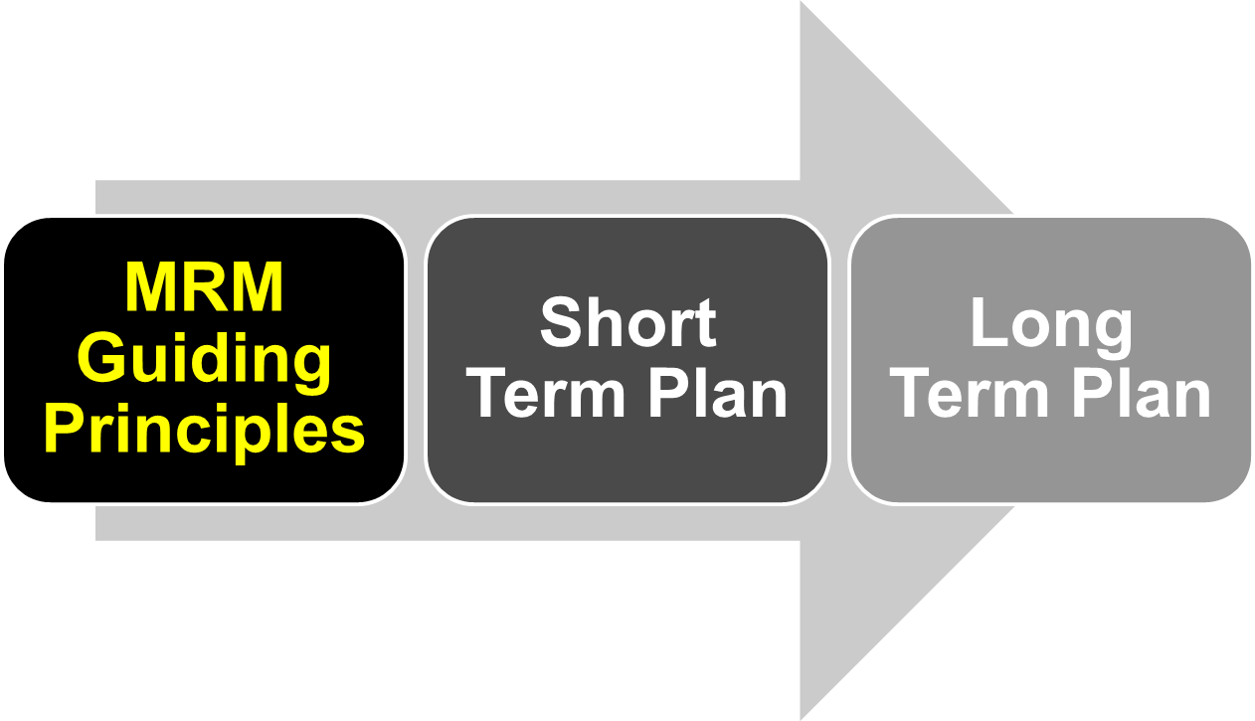
MRM Business Model

Slide 21
MRM Guiding Principles
Enable MRM to become a widely adopted and endorsed de facto standard for municipal services modeling.
Ownership remains with MISA, which includes intellectual property rights, administration, development, maintenance, support, promotion, etc.
Non-profit. Available to municipalities (MISA Members) at minimal cost.

Slide 22
MRM Guiding Principles continued
Support the initial participants to be successful in leading the pack and demonstrating the value of adopting the standard.
Distinction between the pioneers who contributed significantly and the late comers to be considered, but the financial limitations and challenges of different municipalities have to be recognized.

Slide 23
MRM Guiding Principles continued
Services provided are the same regardless of the size of the municipality.
A short term Business Model (initial 12 months to 18 months) is required to address the immediate needs in launching the services; a long term Business Model is required to address future needs in sustaining and furthering the services.
Admit private sector participation, not immediately, but in the future.

Slide 24
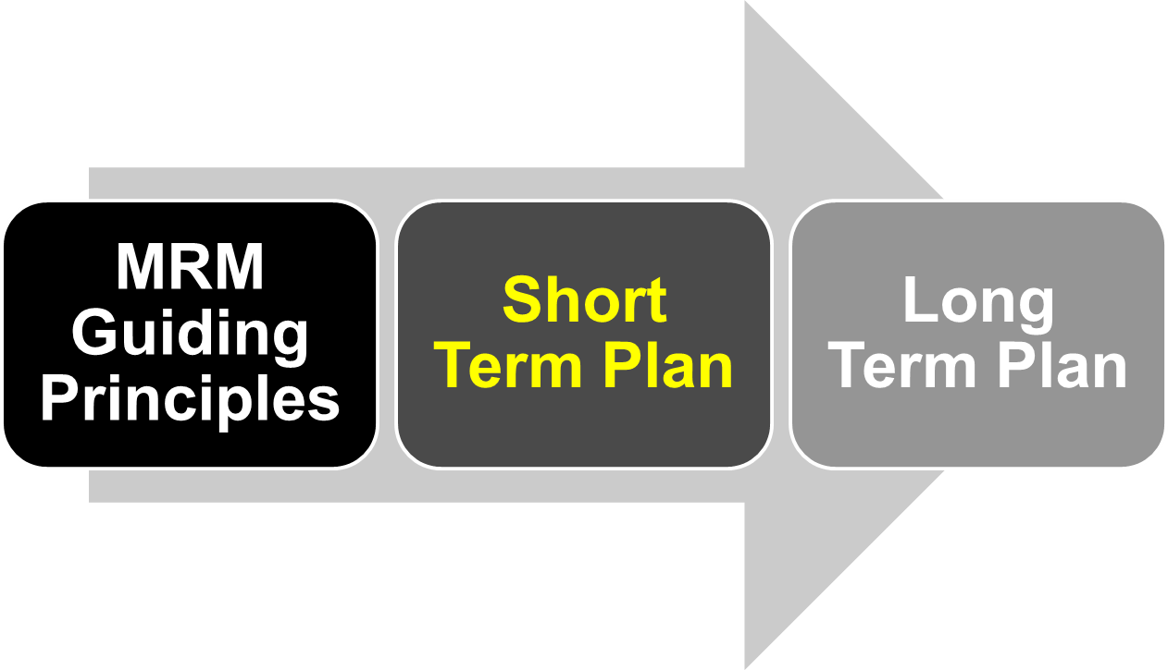
MRM Business Model

Slide 25
Short Term Plan
In return for their initial investment, based on a fee schedule outlined below, municipal subscribers will receive for a period of two years a core set of services which include:
  Access to MRM website for use of tools (already developed);
  Content: meta-model, reference model, use cases, as implemented with the IBM software (System Architect);
  User Guides and instructions on both the MRM principles and use of the software

Slide 26
Short Term Plan continued
  Collaboration with other subscribers (access to other municipalities’ published models)
  Initial training on use of the tools
  Further enhancements to both content and the implementation within the software, as may be developed over that time

Slide 27
Short Term Plan continued
At this time, it appears likely that sustainment and continued development of the service, after the first two years, will require an annual subscription fee to cover operating costs and to maintain access to the services
The need for such an annual subscription fee, and the amount of such a fee (assumed to be a fraction of the initial investment), will be confirmed as part of the longer term Business Plan.
Options which can avoid or reduce the need for such an annual fee will be explored.

Slide 28
Short Term Plan continued
Ongoing support:
  First level being provided by the website vendor,
  e-Solutions, should continue at least for the next 9 –
  12 months
  Second level of support (subject matter expert) to be provided by volunteer resources
  Make use of collaboration forums where questions can be posed and volunteers will commit to monitor and provide answers

Slide 29
Short Term Plan: User Benefits Package
Publicly Available: MRM meta-model; Quick Reference Guide
Full Subscribers
  Modeling Principles Handbook
  Authoritative Reference Model
  Access Quickr Collaboration Site (unlimited) and System Architect (10 hours/month for each $5,000 contribution)
  Access Published “My Municipality” Models on Quickr Site and in System Architect
  MRM Introductory Training (half-day) and System Architect Training (one day)
    One attendee per $5,000 contribution
    Discounted rate for additional attendees
  Participate in MRM Standards Board
  Participate in MRM System Architect User Group (identify and prioritize enhancements)
Content Only Subscribers
  Modeling Principles Handbook
  Authoritative Reference Model
  Access Quickr Collaboration Site (unlimited)
  Access published “My Municipality” Models on Quickr site
  MRM Introductory Training (half-day)
    One attendee per $2,500 contribution
    Discounted rate for additional attendees
  Participate in MRM Standards Board
NOTE:
The continued availability of the Content Only subscription will be reviewed as part of the longer term plan

Slide 30
Existing Subscribers/Revenue
Municipality | Population | Pop. Range | Target | Total Contrib.
Toronto | 2,503,281 | > 500,000 | $25,000 | $37,500
Peel Region | 1,159,405 | > 500,000 | $25,000 | $32,500
York Region | 892,712 | > 500,000 | $25,000 | $32,500
Edmonton | 730,372 | > 500,000 | $25,000 | $60,000
Mississauga | 668,549 | > 500,000 | $25,000 | $10,000
Halton Region | 439,256 | 300,000 - 500,000 | $20,000 | $37,500
Niagara Region | 427,421 | 300,000 - 500,000 | $20,000 | $27,500
London | 352,395 | 300,000 - 500,000 | $20,000 | $30,000
Markham | 261,573 | 100,000 - 300,000 | $15,000 | $22,500
Saskatoon | 202,340 | 100,000 - 300,000 | $15,000 | $10,000
Richmond Hill | 162,704 | 100,000 - 300,000 | $15,000 | $15,000
Waterloo | 97,475 | 50,000 – 100,000 | $10,000 | $7,500
Fredericton | 50,535 | 50,000 – 100,000 | $10,000 | $11,000
Timmins | 42,997 | < 50,000 | $5,000 | $10,000
Joint Councils | n/a | n/a | n/a | $20,000
Total |  |  |  | $363,500

Slide 31
Summary: Existing Contributions
Population Range | # of Municipalities | Target per Municipality | Target Total | Actual Revenue
> 500,000 | 5 | $25,000 | $125,000 | $172,500
300,000 – 500,000 | 3 | $20,000 | $60,000 | $95,000
100,000 – 300,000 | 3 | $15,000 | $45,000 | $47,500
50,000 – 100,000 | 2 | $10,000 | $20,000 | $18,500
< 50,000 | 1 | $5,000 | $5,000 | $10,000
Joint Councils | n/a | n/a | n/a | $20,000
Total | 14 |  |  | $363,500

Slide 32
Expenditures to Date: March 31, 2011
Phase 1: Feasibility
Chartwell | $77,475.82 | Consulting, project planning, project mgmt
Team Travel | $6,336.66 | IBVA Process, attend IBM in Almaden
Meeting Expenses | $534.27 | Room booking and refreshments
Phase 1 Total | $84,346,75
Phase 2: Implementation
IBM Software | $181,041.96 | Rational Products, Lotus Quickr, DB2, Tivoli
Miller Thompson | $12,452.80 | Legal advice for IBM Relationship Agreement
Phase 1 Total | $193,494,76
Operating Costs
e-Solutions | $54,786.54 | Set-up, hosting and support (18 months) – prepaid through to June 30, 2011
IBM Software Renewal | $20,794.18 | Renewal (maintenance for Quickr, DB2, Tivoli
Total Operating | $75,580.72
Grand Total | $353,422.23

Slide 33
Known Cash Flow Requirements:
April 1, 2011 – Dec. 31, 2012
Contributions to Date | $363,500
Expenditures to Date (March 31, 2011) | $353,422 | eSolutions paid through June 30
Unexpended Balance | $10,078
eSolutions 2011 (6 Months) | $15,425 | Due July 1, October 1 for Q3/Q4
IBM Software Renewal (Base Products) | $21,830 | Due Sept. 2011 (2010 + 5%)
Total 2011 Requirements | $37,255
Total to be Raised to end of 2011 | $27,177 | Total less unexpended balance
eSolutions 2012 | $31,775 | Due quarterly, prepaid, 2011 + 3%
IBM Software Renewal (System Architect) | $16,000 | Due March 2012, Estimate Only
IBM Software Renewal (Base Products) | $22,920 | Due Sept. 2012 (same as 2010?)
Total 2012 Requirements | $70,695
Total to be Raised to end of 2012 | $97,872

Slide 34
Proposed Subscriber Fees
Population | Content Only | Content Plus Software
> 500,000 | $12,500 | $25,000
300,000 – 500,000 | $10,000 | $20,000
100,000 – 300,000 | $7,500 | $15,000
50,000 – 100,000 | $5,000 | $10,000
< 50,000 | $2,500 | $5,000

Slide 35
Revenue Projections: Conservative Estimate
 |  | 2011 | 2011 | 2012 | 2012
Population Range | Type | # | $ | # | $ | Examples
> 500,000 | Content + SA | 1 | $25,000 | 1 | $25,000 | Ottawa, Hamilton, Calgary, Winnipeg, Montreal
> 500,000 | Content Only | 0 | $0 | 0 | $0
300,000 – 500,000 | Content + SA | 0 | $0 | 1 | $20,000 | Brampton, Halifax, Laval, Quebec
300,000 – 500,000 | Content Only | 0 | $0 | 0 | $0
100,000 – 300,000 | Content + SA | 0 | $0 | 1 | $15,000 | Burlington, Oakville, Windsor, Regina, Saskatoon, Kelowna
100,000 – 300,000 | Content Only | 1 | $7,500 | 1 | $7,500
50,000 – 100,000 | Content + SA | 0 | $0 | 1 | $10,000 | Moncton, Saint John, Brossard, Wood Buffalo
50,000 – 100,000 | Content Only | 1 | $5,000 | 1 | $5,000
< 50,000 | Content + SA | 0 | $0 | 0 | $0 | Centre Wellington
< 50,000 | Content Only | 1 | $2,500 | 1 | $2,500
Total | Content + SA | 1 | $25,000 | 4 | $70,000
 | Content Only | 3 | $15,000 | 3 | $15,000
Grand Total |  | 4 | $40,000 | 7 | $85,000

Slide 36
Short Term Plan: Projected Cash Flow
 | Cash Flow Requirement | Projected Revenue | Surplus / (Deficit)
2011 | $27,177 | $40,000 | $12,823
2012 | $70,695 | $85,000 | $14,005
2011 – 2012 | $97,872 | $125,000 | $26,828
Notes: Excludes costs for:
Legal fees (MISA will cover for IP?)
Marketing and Promotion
Travel (for training, marketing, promotion)
Project Management
Administration and Support (other than e-Solutions)

Slide 37
Short Term Plan: Tasks / Resources
Task | Resources | Who
System Administration
MRM Help Line (if required) | 1- 2 days/month | eSolutions?
MRM Help eMail Address | 1- 2 days/month | eSolutions?
Technical: software installation, user admin.) | 1- 2 days/month | eSolutions?
User Support/answering questions | 1- 2 days/month | Shared, Quickr forum
System Architect/Model Maintenance
Maintaining Meta Model | 1- 2 days/month | Volunteer
Maintaining Authoritative Reference Model | 1- 2 days/month | Volunteer
Logging/Managing Enhancement Requests | 1- 2 days/month | Volunteer
Managing User Forum (Quickr, Teleconference) | 1- 2 days/month | Volunteer
Developing/Testing/Implementing Enhancements | 2- 5 days/month | Volunteer
* Volunteer includes municipal staff contribution

Slide 38
Short Term Plan: Tasks / Resources continued
Task | Resources | Who
User Training
Prepare half-day MRM Introduction | 1- 2 days/month | Volunteer
Deliver half-day MRM Introduction (locations?) | 3- 5 times 2010-11 | Volunteer
Prepare one-day MRM/System Architect Training | 3- 5 days (one- time) | Volunteer
Deliver one-day MRM/System Architect Training | 3- 5 times 2010-11 | Volunteer
Deliver Advanced System Architect Training |  | 3rd Party
Marketing and Promotion
Develop Marketing Look and Feel | One Time | Volunteer
Develop Marketing Materials (brochure, emails, web site info, presentation, video) | One Time | Volunteer
Maintain/Update Marketing Materials | 1- 2 days/month | Volunteer
Deliver Marketing presentations | 1- 2 days/month | Volunteer
Respond to Information Requests | 2-5 days/month | Volunteer
* Volunteer includes municipal staff contribution

Slide 39
Short Term Plan: Tasks / Resources continued
Task | Resources | Who
Financial Administration
Issue invoices and process payments | 1- 2 days/month | MISA
Manage funds/financial reporting | 1- 2 days/month | MISA
Partner Development and Relations
Update IBM Relationship Agreement | 1- 2 days, one time | Volunteer
Update/Renew KPMG Relationship | 3- 5 days, one time | Volunteer
Review Hosting/Support Arrangements (eSolutions, IBM Cloud, etc.) | 5-10 days, one time | Volunteer
Investigate/Recommend Training Partner Arrangements/Certification Process | 5-10 days, one Time | Volunteer
Investigate/Recommend Consulting Partner Arrangements/Certification Process | 5-10 days, one time | Volunteer
Manage Training/Consulting Partner Agreements | < 1- 2 days/month (if required) | Volunteer
* Volunteer includes municipal staff contribution

Slide 40
Short Term Plan: Tasks / Resources continued
Task | Resources | Who
Legal Agreements (work with MISA Legal Counsel – Miller Thomson)
Update IBM Relationship Agreement | 1 day, one time | Volunteer
Develop KPMG Relationship Agreement | 3-5 days, one time, if required | Volunteer
Develop Municipal Subscriber Agreement | 1-2 Days | Volunteer
Determine and implement approach to protecting MRM IP | 5-10 days, one time | Volunteer
Obtain release from Province of Ontario, Government of Canada for “shared” IP | > 10 days, one time | Volunteer
Develop training and/or consulting partner legal agreements or certification agreements | 5-10 days, if required | Volunteer
Manage Training/Consulting Partner Agreements | < 1-2 days/month (if required) | Volunteer
* Volunteer includes municipal staff contribution

Slide 41
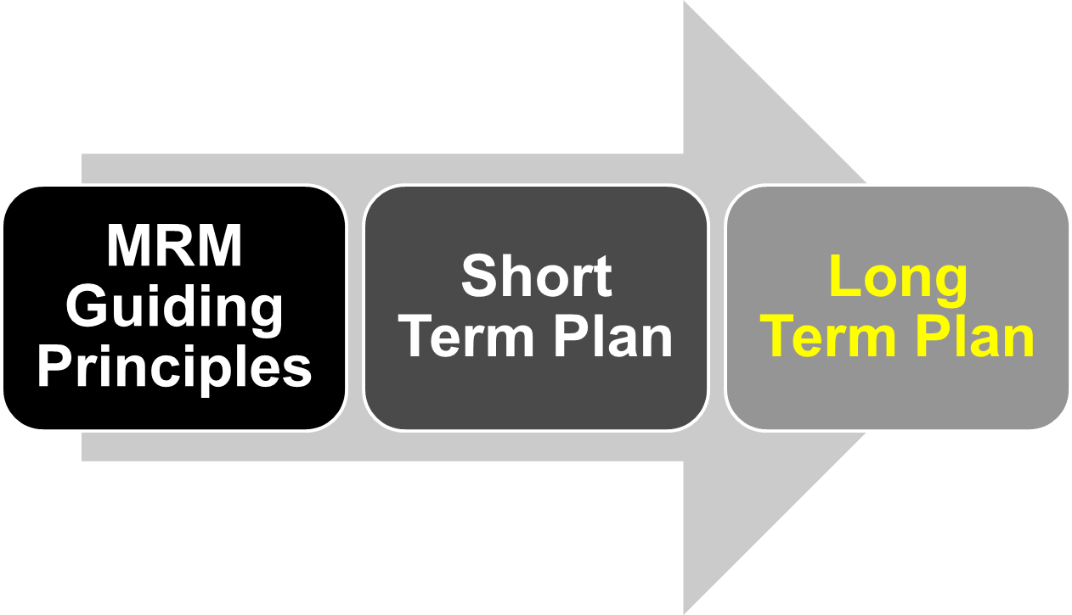
MRM Business Model

Slide 42
Long Term Plan: Opportunities for Investigation
e-Solutions contract or alternative hosting arrangement (e.g. IBM Cloud)
IBM Software Renewal (will IBM waive all or part of fees?)
Revenue/Royalty arrangement with IBM
Revenue from Training/Consulting Certification and/or course delivery
Government Grants
Joint Councils and/or F/P/T interest/contribution

Slide 43
Long Term Plan: Risks / Added Costs
Additional SA Licenses
Availability of Volunteer Resources
Ongoing viability and costs post-2012

Slide 44
Long Term Plan: Role of MRMv2 Steering Committee
Assist in developing the MRMv2 long
term strategy and vision
Hold an MRMv2 visioning session
MISA Ontario Board

Slide 45

Long Term Plan: Still Lots To Do
MRMv2
2+ years of work
is just the tip of the
iceberg
“We have only just
begun”

Slide 46
System Architect Demo
Screen Shots

Slide 47
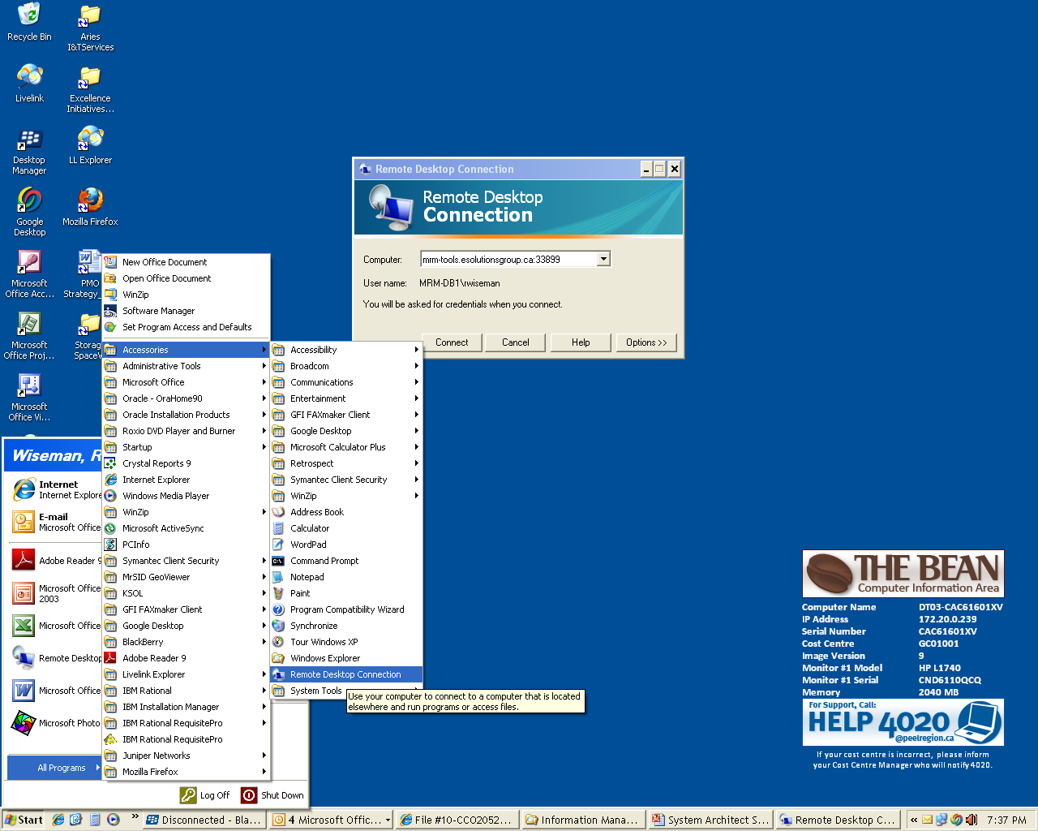

Slide 48
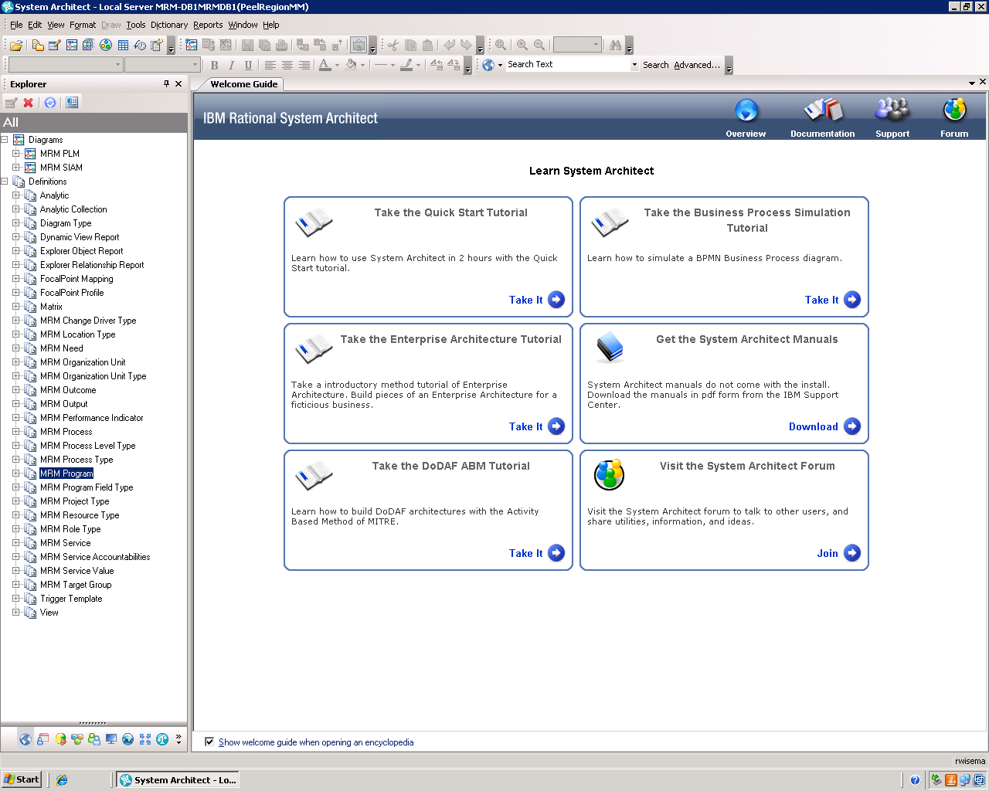

Slide 49
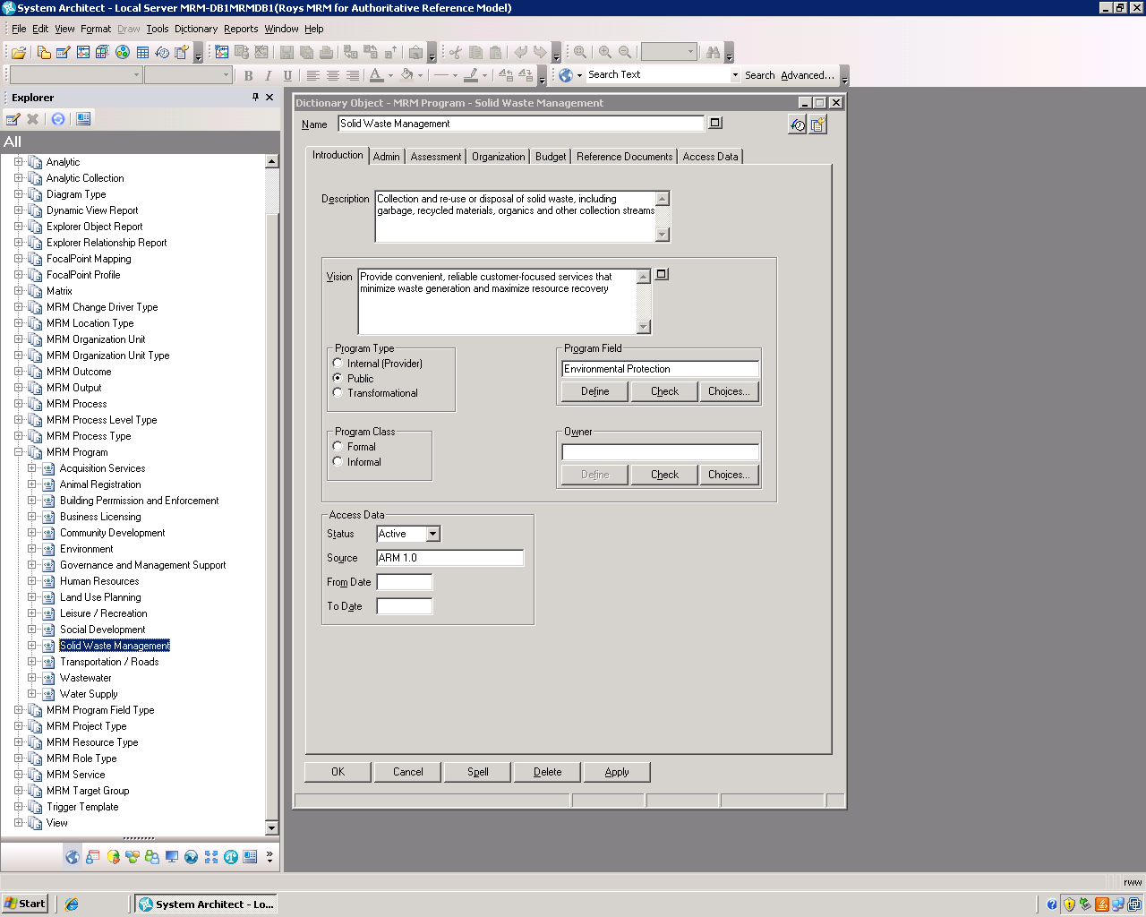

Slide 50
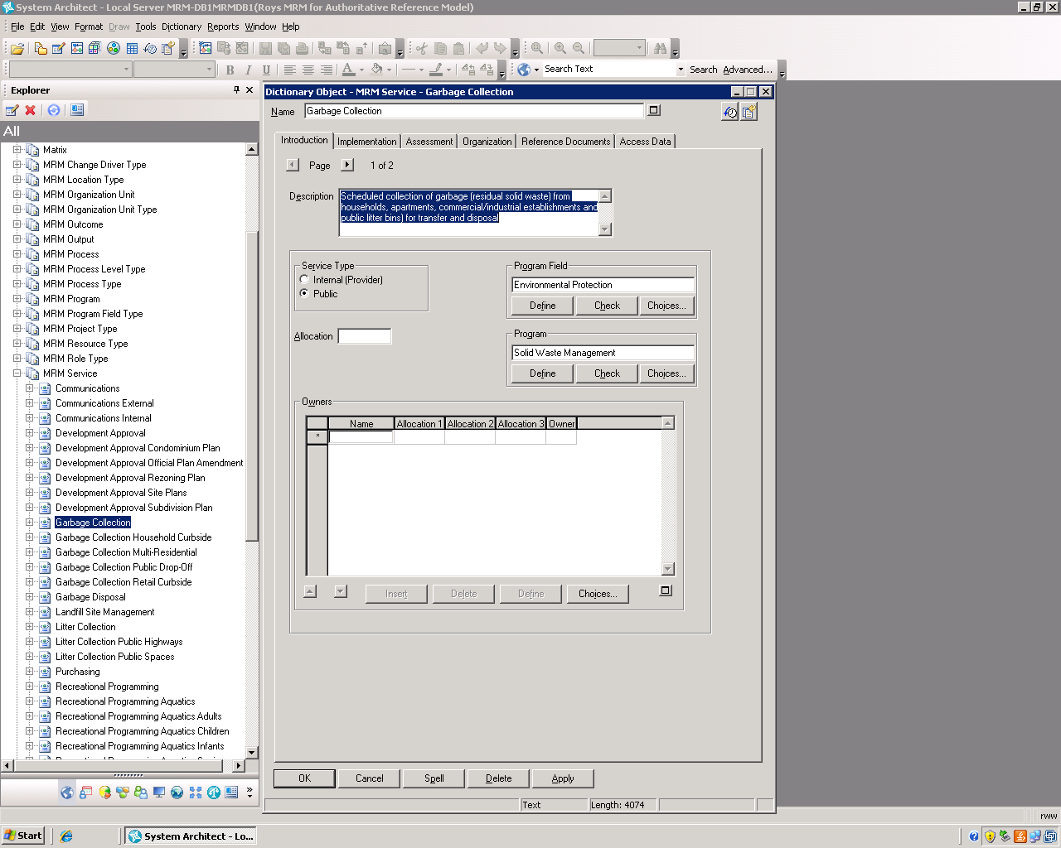

Slide 51
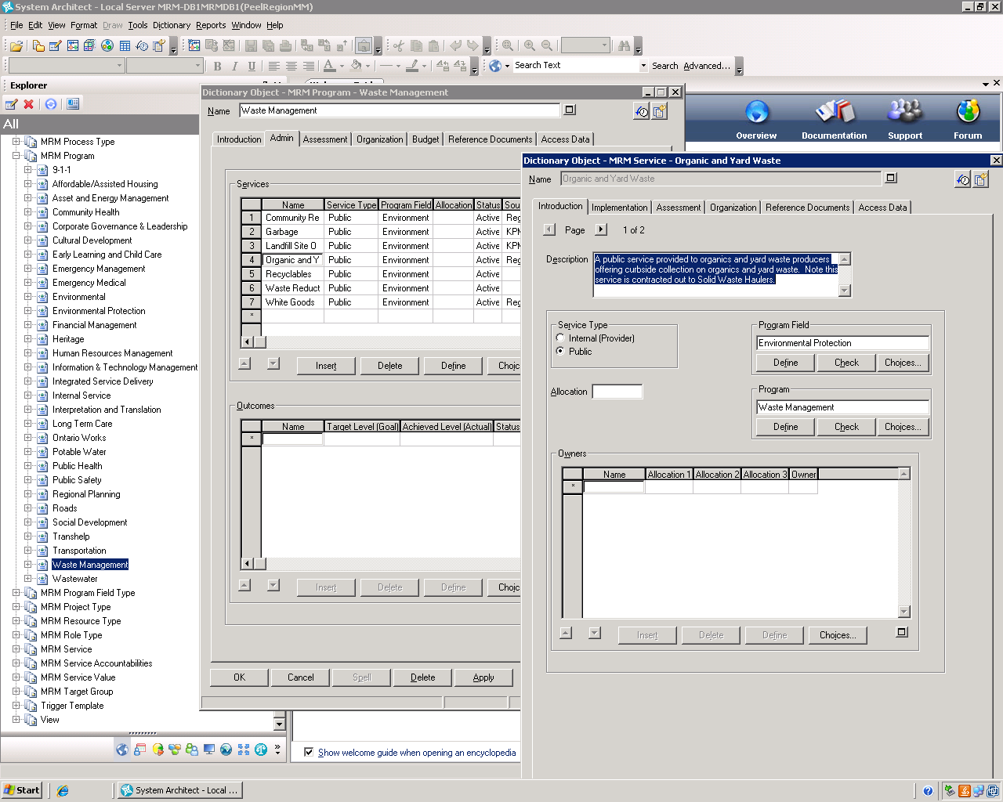

Slide 52
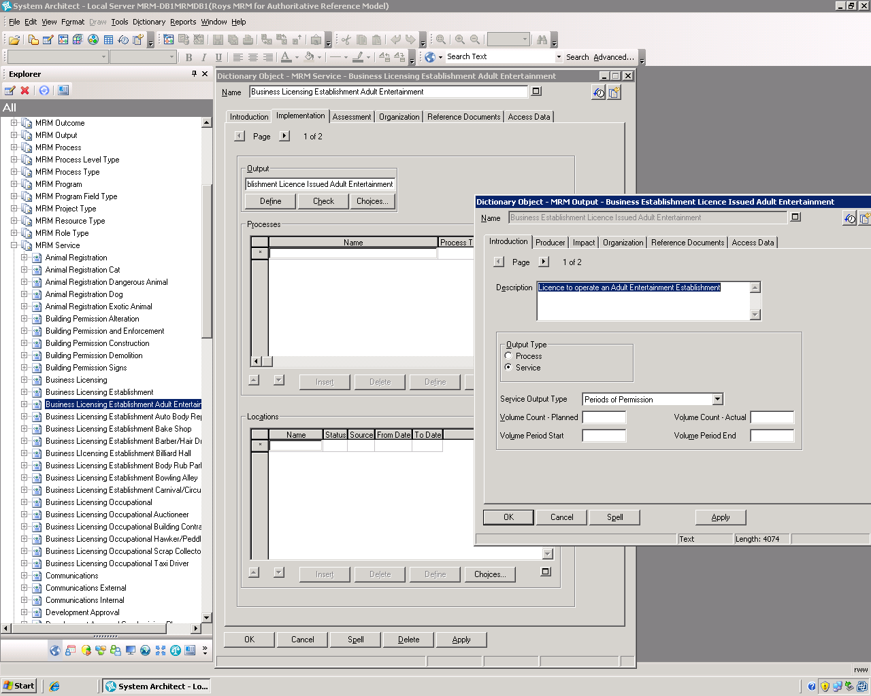

Slide 53
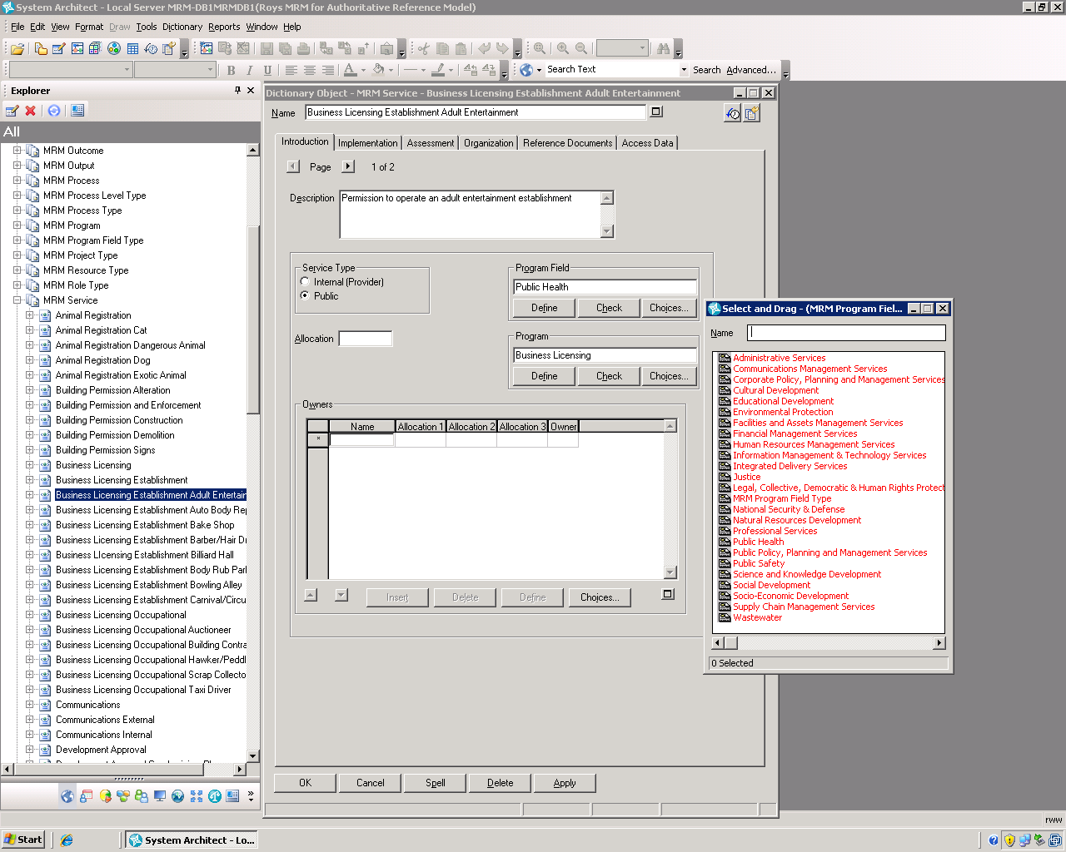

Slide 54
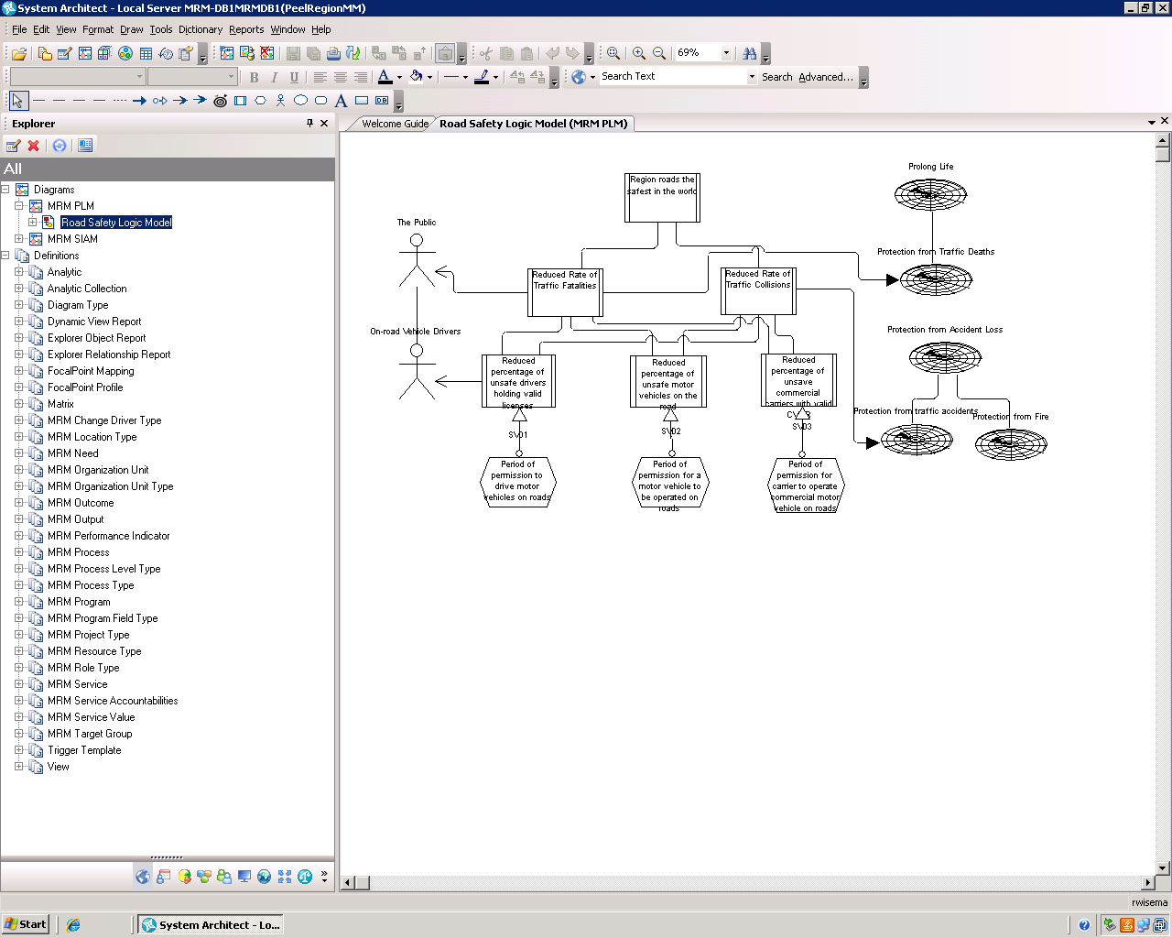

Slide 55

Questions/Comments

